Slide 1
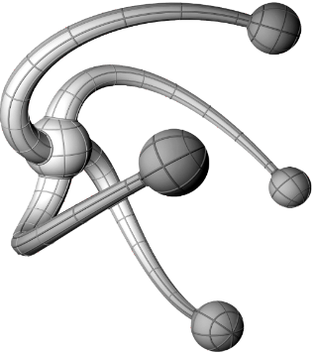

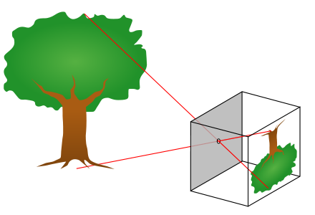
Measuring the Quality of Squats and providing feedback using 3D Depth Maps
Department of Computer Science
Andrew Dao (MEng)*, Supervisor: Sion Hannuna*
*Computer Science Department, Engineering Faculty, University of Bristol
Background
3D Joints
Injuries play a substantial role in sports and can prevent the most seasoned athletes from training for months or even years. Additionally, Injuries are often caused by incorrect form and can only be corrected through the guidance of experienced individuals, often being expensive and inconvenient. This project focuses on automatically assessing the quality of squats and providing guided feedback in aims of preventing or even reducing the likelihood of injury in commercial situations. This task is approached as an action recognition problem, splitting squats into good and several bad categories. By extracting temporal pose features a regression model can be trained, and subsequently used to classify squats into one the several classes.
Converting 2D coordinates to 3D coordinates is a common problem that is modelled by the pinhole camera model. Thus for every joint coordinate (x,y) the depth, Z, could be obtained using the depth map. However, the depth and RGB image were collected from different cameras in the Kinect that had different intrinsic and extrinsic parameters with different distortion in images, resulting in depth and RGB images with different resolutions that were incomparable without any further processing; this problem was not a simple matter of reducing the dimensions to be equal.
Camera parameters for both cameras were provided allowing allowing me to execute the follow steps to map the depth map onto the RGB image:
Using the provided distortion coefficients, the RGB and depth images were undistorted
using the depth camera Intrinsic the depth coordinates were mapped into 3D space using the following formulae:
The generated 3D coordinates are then mapped onto the colour image with the following
Data Collection
Dimensionality Reduction
In order to carry out this task, I had to collect my own data as no previous datasets on assessing the quality of squats using depth were available to my knowledge. Using the Kinect V2, I obtained RGB and depth information while instructing the subject to perform good squats and 4 variations of bad squats. This consisted of mistakes in squats that typically resulted in injury such as squats that had a rounded back, knee bent inwards, knees too far forward and shallow squats.
Camera viewpoints were pre-positioned enabling all useful joint information to be recorded by preventing occlusion; the user performed squats face on towards the camera and diagonally-side on. Although this may make my model less robust to occlusion, users will be performing squats in a controlled environment allowing me to avoid common problems in AR such as occlusion of the subject, angle of recorded data and lighting conditions.
All videos were manually labelled and assessed by me. The class, start and end of the squats were labelled.
The final data consisted of 13 3D joints for every frame or in other words 39 points. Each squat comprised of 70 frames and was define as a concatenation of all 39 joints for 70 frames giving a feature vector of length 39*70 i.e. 2730 features for every squat. To reduce the computational complexity and to deduce correlations between features, Principal Component Analysis (PCA) was used. This works by mapping data points onto a new set of axis known as the Principal component axis. The maximum number of principal component axis that can be generated is equal to the number of features. Moreover the first principal component axis has the largest eigenvalue and variance in the data, in other words contains the information that we are most interested in. By discarding principal axis with the smallest variance we can reduce the dimensionality in the data while minimising the loss in information. The number of dimensions kept, is then a matter of trading off between speed and loss of information. Using PCA the dimensions were reduced from 2730 features to 15 features.
2D Joints
Classification AND Feedback
Using the RGB images collected by the Kinect, OpenPose was used (an open-source library) to generate a skeletal representation of the user, consisting of 18 2-Dimensional joints. Joints were generated for each frame of every video and were used to provide a representation of the image by specifying local parts of the image.
This aided in making the model robust to cluttered backgrounds and partial occlusions However, squats were also performed from a side on angle, resulting in 0 value joints in particular frames due to occlusion. These values were interpolated in order to avoid mathematical problems with methods employed later such as principal component analysis.
Additionally, due to differences in execution and speed of squats, the number of frames for each squat was resampled to a fixed length (WHY?). Furthermore, face and neck joints were discarded as they didn’t add any useful information and increased the dimensionality of features; this resulted in 13 2-D joints.
Each squat consisted of 15 features points in the principal axis and an corresponding label. All 100 squats were fed into a Medium Gaussian Support Vector Machine. For Testing the dataset, I use 10 fold cross validation, achieving an overall accuracy of 90%. Classes were classified into 1 of 5 classes: Good Squat, Bent Knees, Shallow Squat, Rounded back, Knees forward Squat.
If classified as a bad squat, prior domain knowledge is used to identify which joints are likely to be the cause of the problem. In the future, an image detailing what injury could happen as a result of that bad form and steps to fix it will be introduced.

